Slide 1

Spring of Code
Artificial Intelligence
(Machine Learning & Deep Learning)
Instructor
Asad Ullah
- Research Assistant (DIP Lab)
Duration
03 Months
(Feb – April)

Slide 2

Day 01 – Exploratory Data Analysis
(Introduction to NumPy)
Objectives:
What is Exploratory Data Analysis?
Introduction to NumPy
NumPy Arrays

Slide 3
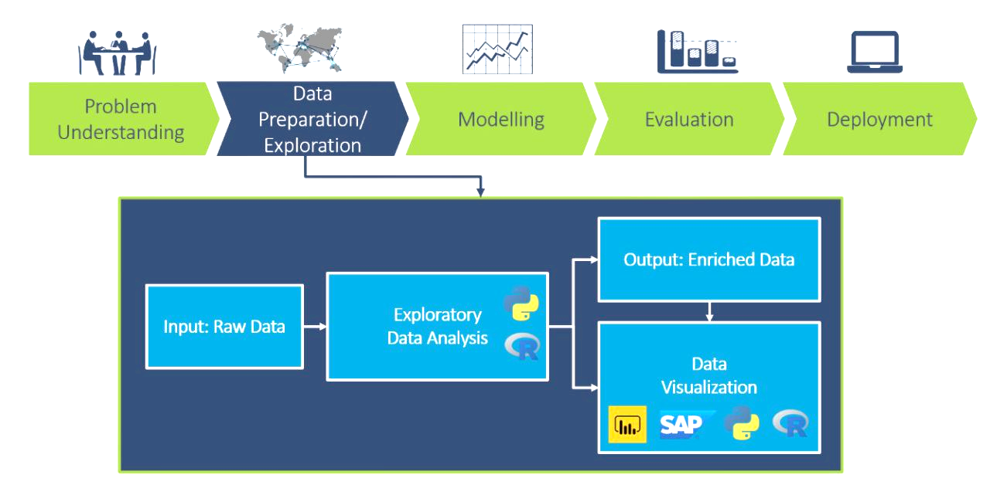
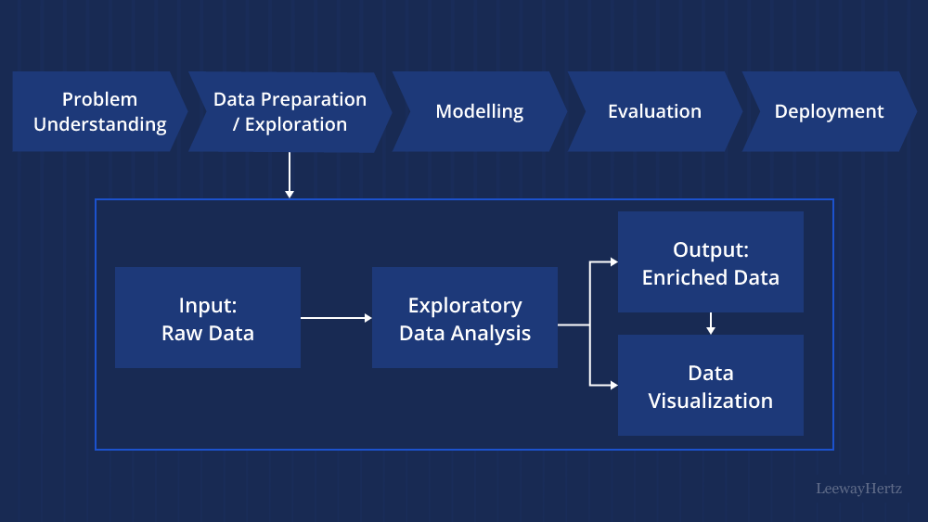
Exploratory Data Analysis
The process of examining datasets to summarize their main characteristics. It is a crucial step in the data analysis workflow to gain a deep understanding of the dataset before modeling.
Notes:
NumPy and Pandas are essential for data manipulation
Data visualization helps students see patterns and understand data quality
Data Manipulation refers to the process of cleaning, transforming, and restructuring data to make it suitable for analysis.

Slide 4
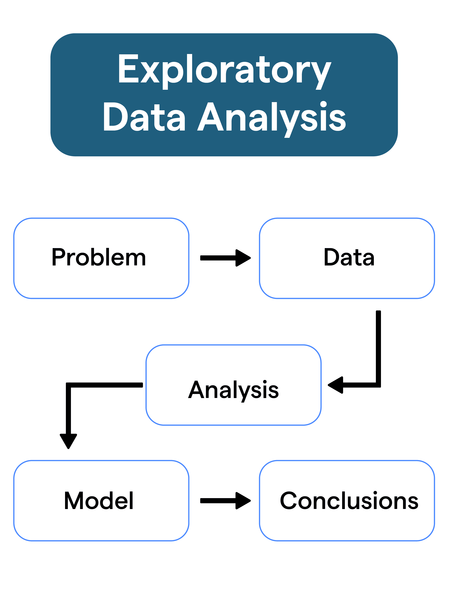
Exploratory Data Analysis
The process of examining datasets – often with visual methods – to summarize their main characteristics.
It is a crucial step in the data analysis workflow to gain a deep understanding of the dataset before modeling.
Objectives:
  Understand data structure and underlying patterns.
  Identify anomalies, missing values, and outliers.
  Detect trends and relationships between variables.
  Form hypothesis to inform further analysis or modeling.
Importance:
  Provides insights for data-driven decision making.
  Improves predictive model quality by identifying issues early.
  Ensures data integrity and readiness for analysis.
Notes:
Anamoly: something different, abnormal
Outlier: A data point that lies far from the other values in the dataset.
Correlation describes the relationship between variables.
This means using EDA to generate initial ideas or assumptions about your data.
Sales are positively correlated with temperature.
Data-driven means making decisions based on actual data and analysis, not intuition or guesswork.
✅ Examples:
A business uses customer purchase data to decide which products to promote.
A hospital analyzes patient data to identify high-risk groups for certain diseases.
An e-commerce platform personalizes recommendations based on browsing history.

Slide 5
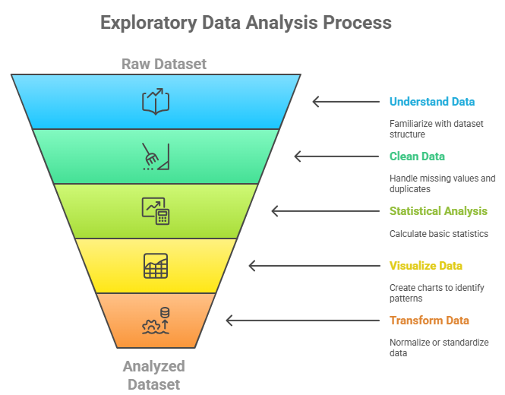
Key Steps in EDA
Understanding the Data: Get familiar with the dataset, check number of rows, columns, and data types.
Data Cleaning: Handle missing values, duplicates, and inconsistencies.
Statistical Analysis: Use basic statistics (mean, median, standard deviation) to summarize each variable.
Data Visualization: Use charts to uncover patterns, trends and outliers.
Data Transformation (if needed): Normalize or standardize values, or convert data into a better format for further analysis or modeling.
Notes:
Understand with statistics - Get basic numerical understanding
Transform last - Based on what you discovered, decide what transformations are needed
What EDA looks like for non-tabular data:
🔹 Image Data EDA
- Display sample images from different classes
- Check image sizes, aspect ratios, and color channels

Slide 6




Python Libraries for EDA
NumPy: Essential for numerical operations in Python, it provides support for multi-dimensional arrays, along with mathematical functions on these arrays.
Pandas: Library for data manipulation and analysis. It makes it easy to clean, transform, and aggregate data.
Matplotlib: A versatile plotting library used to create static, interactive, and animated visualizations in Python.
sklearn: Primarily a machine learning library but includes many tools useful for data preprocessing and feature selection, which are key parts of EDA.

Slide 7
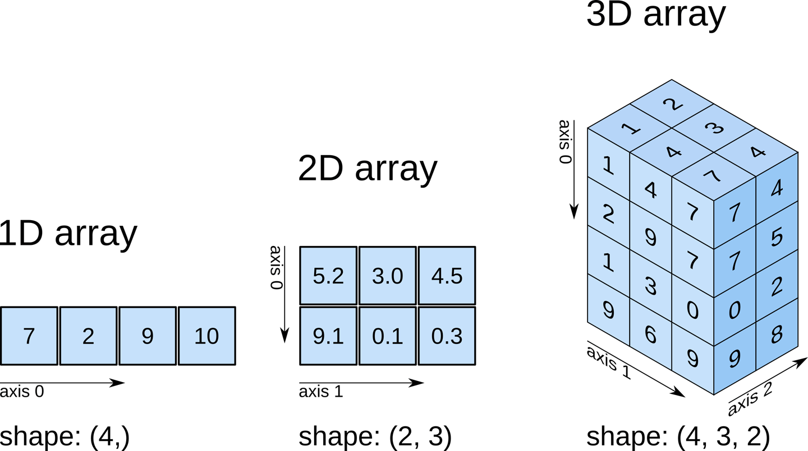
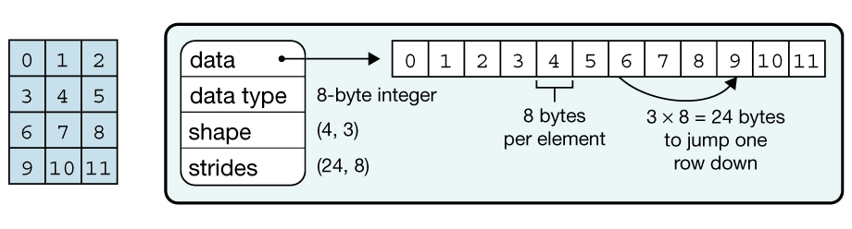
Introduction to NumPy
NumPy: “Numerical Python” – The foundation of scientific computing in Python
  Initial release: As Numeric (1995); as NumPy, (2006)
  Python library for efficient array operations and mathematical computations
  Core Data Structure: N-dimensional array (ndarray)
Why NumPy?
  Speed: Up to 50x faster than Python lists.
  Memory Efficient: Uses less memory than traditional Python data structures.
  Foundation: Backend for Pandas, SciPy, Matplotlib, and machine learning libraries
  Versatile: Supports 1D arrays, matrices, tensors, and higher dimensions.
Notes:
- Scientific computing involves using computational methods to solve complex scientific and mathematical problems.
Numeric (1995):
First version was called "Numeric" or "Numerical Python"
Created by Jim Hugunin at MIT
Evolution to NumPy (2006):
Travis Oliphant led the creation of NumPy

Slide 8
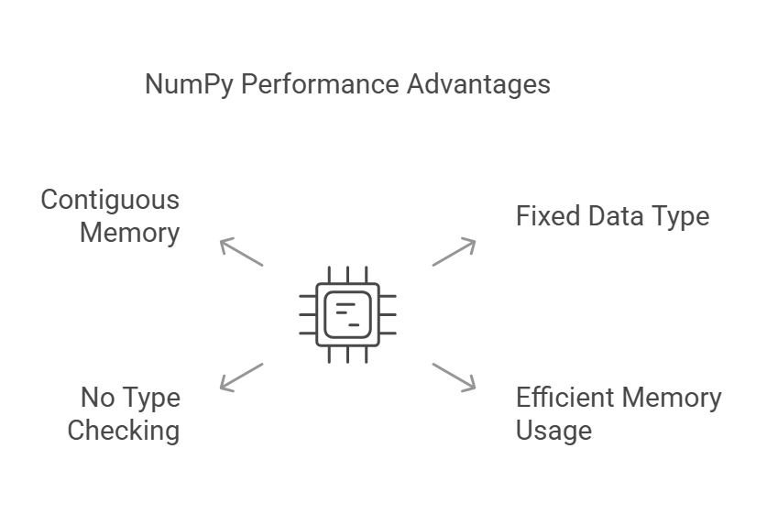
Why NumPy Arrays are Faster Than Lists
Fixed Data Type:
  NumPy arrays have a uniform data type, which eliminates the overhead of managing different data types like in Python lists.
Contiguous Memory Storage:
  Data stored in continuous memory blocks enhances cache efficiency and reduces memory consumption.
No Runtime Type Checking:
  Operations on NumPy arrays skip runtime type checks, making computations faster compared to Python lists.
Optimized Implementation:
  Core operations written in C and Fortran for maximum performance.
Differences Between Python Lists and NumPy Arrays:
Feature | Python Lists | NumPy Arrays
Data Type | Mixed Types | Homogeneous types
Memory Efficiency | Low | High
Computation Speed | Slow | Fast

Slide 9

Thank You

